Slide 1
App Store Reviews & Recommendation for Suitable Platform
S. Srividya
30-Mar-2021

Slide 2
Background:
You’re working for a marketing consultancy firm.
One of our clients is a company that designs operating systems,
They want to build a major apps store into their user interface.
To this end, they want to know whether Google Play apps have higher reviews on average than Apple Store apps (or vice versa) , as they’re intending to strike a deal with just one of these companies

Slide 3
Scope of Work
Collate the App review responses on “Google Play apps & Apple Store apps”.
Analyze the reviews & recommend suitable platform / app store to client using DSP (Data Science Pipeline) principles.

Slide 4
DSP Process Flow:
Sourcing and Loading data
Cleaning, Transforming & Visualizing data
Modeling data
Evaluating, presenting findings, and concluding your work

Slide 5
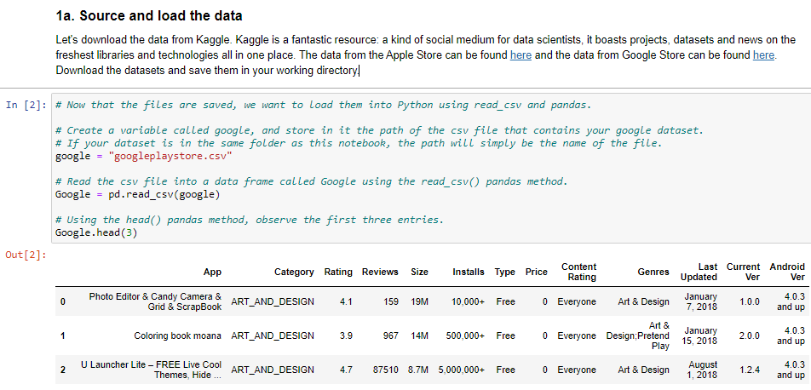
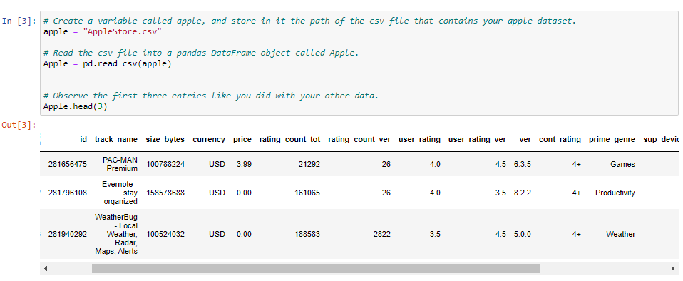
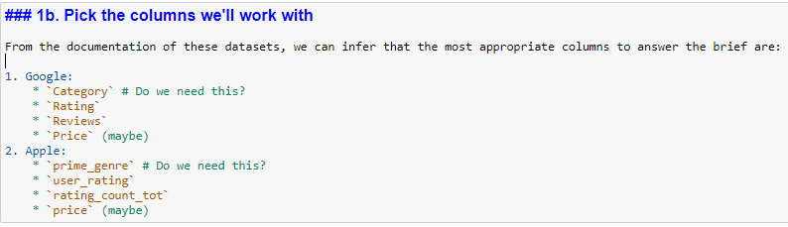
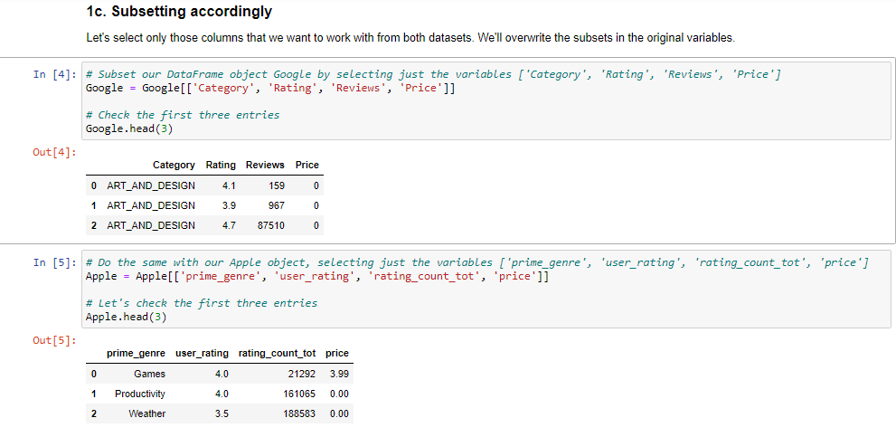
Sourcing & Loading data
3 Critical Steps followed:
1) Load the two datasets, 2) Pick the columns to work with.. 3) Subsetting the data

Slide 6
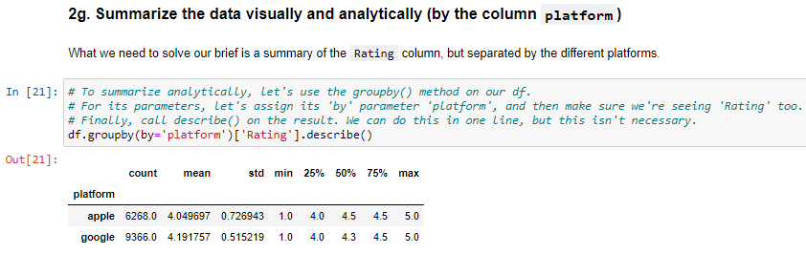
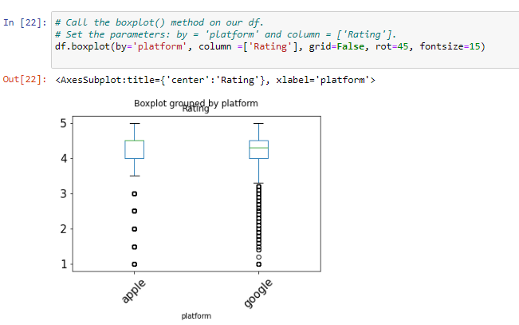
Cleaning, transforming & VISUALIzing data
Steps Involved:
Check the data types and fix them
Add a platform column to both the Apple and the Google data frames
Changing the column names to prepare for a join
Join the two data sets
Eliminate the NaN values
Filter only those apps that have been reviewed at least once
Summarize the data visually and analytically (by the column platform)
Key Outcomes:

Slide 7
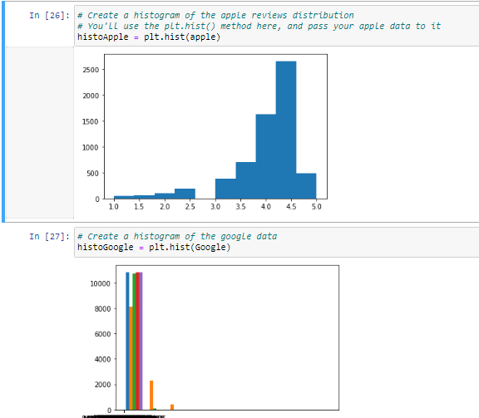
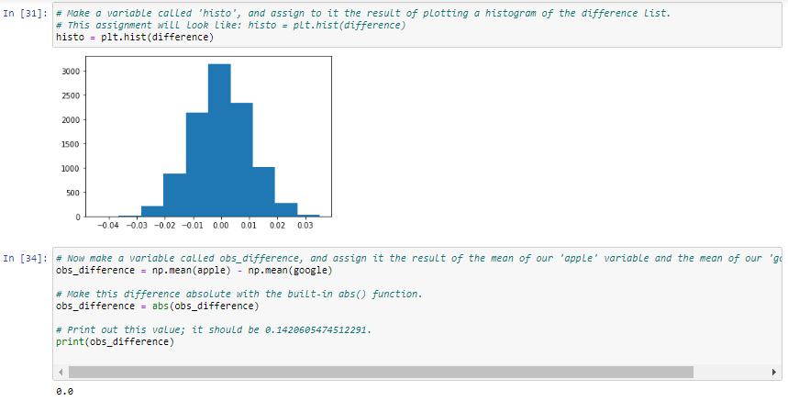
Modeling data
Distribution of data
Permutation Analysis
Steps Involved:
Hypothesis formulation
Getting the distribution of the data
Permutation test

Slide 8
Outcome & Proposal
DSP workflow outcome clearly indicates / recommends the following,
App Store Platform (Google Play or Apple Play) has an impact on the ratings / reviews of the apps (refer outcome of sourcing, loading, cleaning & transforming data)
Google play apps receive better reviews than Apple Store Apps. (refer outcome of data modeling)
Proposal is to proceed with “Google Play Store Apps”…

Slide 9
Thanks

